Slide 1

2027 1ST EKO CLUB INTERNATIONAL
QUARTERLY
MEETING
& ECAT 15TH ANNIVERSARY
MARCH 18–21, 2027 • AUSTIN, TEXAS
“Honoring Our Heritage, Celebrating Our Journey, Building Our Future.”

Slide 2

THE AUSTIN EXPERIENCE
One Heritage. One Mission. One Eko.
A premium convention experience created for connection, service, culture and celebration.
CONNECT
Renew friendships and strengthen relationships across Eko Club chapters.
SERVE
Create meaningful community impact through youth engagement and outreach.
CELEBRATE
Honor ECAT’s heritage and 15-year journey with memorable shared experiences.

Slide 3


TRAVEL & ACCOMMODATION
Arrival, Airport & Host Hotel
Plan your arrival with ease and enjoy a convenient ECAT home base in Austin.
AUSTIN-BERGSTROM (AUS)
HOLIDAY INN AUSTIN AIRPORT
HOST HOTEL
CONVENIENCE
RESERVATION
Holiday Inn Austin Airport by IHG
6711 E Ben White Blvd, Austin, TX 78744
Approximately 5 minutes from AUS with airport shuttle service available for guests.
Special convention booking arrangements; group link/code will be published when confirmed.

Slide 4
THURSDAY • MARCH 18, 2027
Arrival, Welcome & Cruise
Warm hospitality, relaxed networking and an unforgettable opening experience.
AFTERNOON • WELCOME
Guest arrivals, check-in, hospitality desk, introductions and chapter fellowship.
EVENING • ECAT 2027 BOAT CRUISE
Dress Like a Sailor! • $100 per person
First come, first served. Registration opens next week on the ECAT website.
LATE EVENING • AFTER-PARTY
Music, conversation and relaxed connection at the hotel.

Slide 5
FRIDAY • MARCH 19, 2027
Fellowship & Black-Tie Celebration
A day of fellowship, reflection and an elegant evening of style and celebration.
7:30 AM
Breakfast
Begin the day together with greetings and informal fellowship.
12:30 PM
Jumu’ah Prayer
Dedicated time for Muslim members and guests to observe Friday congregational prayer.
1:30 PM
Lunch
A shared meal and relaxed afternoon connection before the evening program.
EVENING
Black-Tie Event
An elegant evening of style, fellowship and celebration. Formal black-tie attire is encouraged.
ELEGANCE • FELLOWSHIP • CELEBRATION

Slide 6
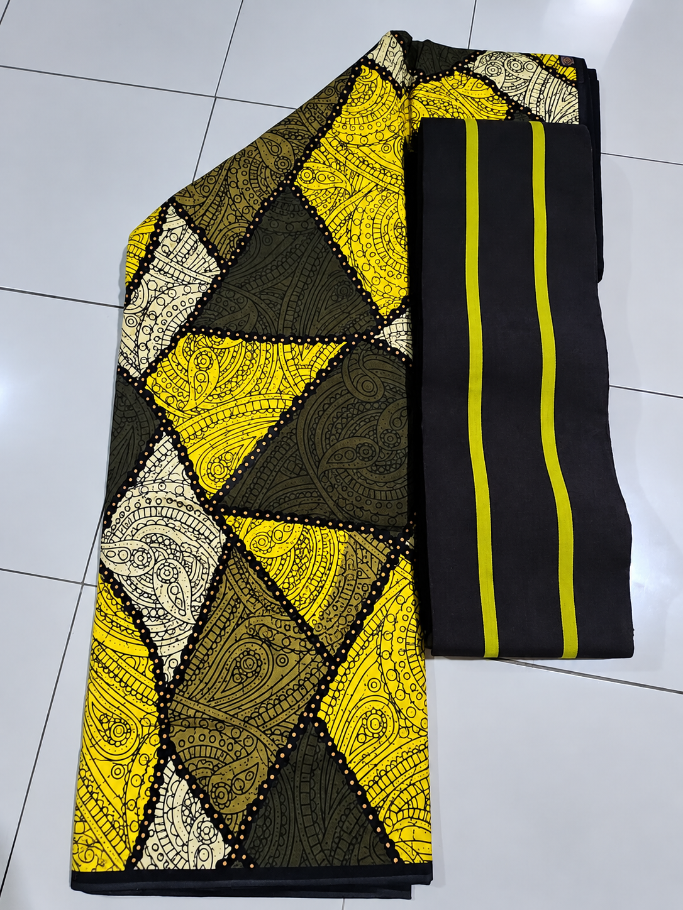

SATURDAY • OFFICIAL ECAT ANKARA
Heritage in Style • Grand Finale
Celebrate our shared identity in the official Classic ECAT Ankara & Fila.
PRICE
$100 per piece
BOOKING NOW OPEN
Members and guests can start reserving their ECAT Ankara now. Contact any ECAT member.
SATURDAY GRAND FINALE
Wear it with pride. Represent ECAT with distinction.

Slide 7
SATURDAY • MARCH 20, 2027
Community, Business & Grand Finale
The anchor day: wellness, youth impact, leadership business and our Ankara celebration.
MORNING
Walk for Life
Wellness, movement and friendship.
MORNING
Breakfast
Breakfast and fellowship following the walk.
LATE MORNING
Youth Forum & Community Outreach
Engaging young people and creating meaningful local impact.
AFTERNOON
First Quarter General Meeting
Formal Eko Club International business, reports and forward planning.
AFTERNOON
Lunch
Meal break and networking opportunity.
EVENING
Grand Finale • Classic ECAT Ankara & Fila
Heritage, recognition, entertainment, fellowship and Naija party energy.

Slide 8
SUNDAY • MARCH 21, 2027
Thanksgiving, Brunch & Farewell
A gracious close to the weekend — gratitude, fellowship and safe journeys home.
SUNDAY DEVOTION
BREAKFAST / BRUNCH
FAREWELL & DEPARTURE
A reflective moment of thanksgiving for the gathering, the organization and the journey ahead.
One final shared meal, photos, conversations and exchange of good wishes.
Official close of the weekend as delegates check out and begin their journeys home.
“We leave Austin with renewed friendships, stronger bonds and a shared commitment to Unity, Heritage and Service.”

Slide 9
PARTNER • ADVERTISE • MAKE AN IMPACT
Brochure Advertisement & Contact Information
2027 First Quarterly Meeting of Eko Club International • ECAT 15th Anniversary
ADVERTISEMENT RATES
SUBMISSION
Full Page
$100
PDF artwork • ads@ekoclubaustintx.org
Center Page
$300
PAYMENT
Inside Back Cover
$300
Zelle: ekoaustin2023@gmail.com • Send receipt to 281-760-9056
Inside Front Cover
$500
CONTACTS
Back Cover
$500
Hon. Philip Soneye: 281-760-9056
Hon. Gloria Osamor: (832) 231-5983
Hon. Caroline Oyedeji: (832) 259-2171
Hon. Jomiloju Ajayi: (832) 716-5977

Slide 10
SEE YOU IN AUSTIN
ONE HERITAGE. ONE MISSION. ONE EKO.
Thank you. We look forward to welcoming the Eko Club family to Austin.
MARCH 18–21, 2027 • AUSTIN, TEXAS
Visit Our Website www.ekoclubaustintx.org for Updated information

